Slide 1
ASP.NET MVC 5 with Developement Patterns
MVC Security and Identity Framework
Copyright © 2016 Adrian Ilewicz

Slide 2
Module agenda
Authentication vs Authorization
MVC security layers
Controlling access to resources
Designing secure applications
Microsoft ASP.NET Identity Framework
OAuth – integrating your application with Facebook

Slide 3
MVC Components
ROUTING
MODELS
CONTROLLERS
VIEWS
TESTS

Slide 4
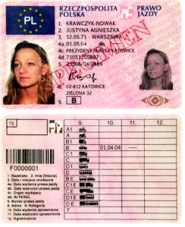
Authentication vs Authorization
Authentication – who are you?
Authorization – what can you do?
Authentication
Authorization

Slide 5
Security has layers
First bastion - IIS
IIS
Basic
Digest
Windows
Anonymous
Notes:
Basic – przekaż nazwę i hasło czystym tekstem w nagłówku
Digest – przekaż hasz hasła
Windows – uwierzytelnianie w domenie
Anonymous – wpuść wszystkich
Jeśli planujesz uwierzytelniać na poziomie aplikacji musisz ustawić Anonymous

Slide 6
ASP.NET Authorization
Anonymous
Identity
Providers + Oauth
Tokens + Claims
Windows
ASP.NET
Anonymous
Identity
Windows
Providers / OAuth
Tokens + Claims

Slide 7
Tożsamość w chmurze
Poza domeną tożsamości
Zbyt dużo „wysp” tożsamości
Obecne techniki są skomplikowane lub niekompatybilne
Zarządzanie kontami stron trzecich w twoim systemie jest ryzykowne

Slide 8
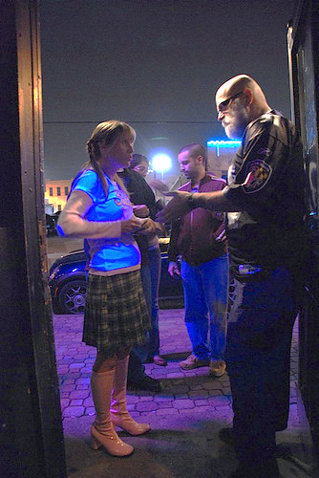
Wchodzi Adrian do lokalu …
Notes:
Three geeks walk into a bar in California. The bouncer asks for ID. You whip our your drivers license from the state of Ohio. They inspect it, flash a purple light thing at it, verify your age, and let you in.
They didn’t force you to register with them to get a bar credential. You would end up with a ton of credentials you were forced to use (like those grocery store customer loyalty cards). The bar trusts the credentials from a trusted provider (and has ways to validate those credentials are valid (the light, and known emebedded security features)).

Slide 9
Token and Claims
Token jest zbiorem bajtów wyrażających informacje o tożsamości
Taka informacja zawiera jedno lub więcej praw
Każde prawo zawiera informacje o jednostce do której należy token
Token
Example Claims
Claim 1
Claim 2
Name
Wskazuje kto utworzył ten token i strzeże go przed zmianami
Group
Claim 3
. . .
Age
Claim n
Signature

Slide 10
Secure Token Service
REQUEST
IIS
REDIRECT
REQUEST WITH TOKEN
REQUEST WITH TOKEN
REQUEST WITH TOKEN
REQUEST
TOKEN
STS
Active Directory
Custom
Membership

Slide 11
ASP.NET MVC Identity 2.1 framework
Authentication and authorization framework
Generic, i.e. not tied to particular framework
… but 99% of examples uses Entity Framework
Allows for easy implementation of every aspect of security
Relies heavily on interfaces
Interfaces are splitted into large number to not require implementing ‚everything at once’ (yeah, it’s not Windows 8☺)
http://www.asp.net/identity

Slide 12
MVC Built-in authentication providers
Microsoft (LIVE organizational accounts, i.e. Office 365)
Google
Facebook

Slide 13
Designing secure applications
Keep things simple!
Overwhelming & complex security layers makes a lot of space for security holes!
Implement only necessary interfaces
Securing app is a proces!

Slide 14
Controlling access to resources
[Authorize] attribute
For user name
For role name
[AllowAnonymous] attribute
[Authorize(Roles="Accounting, Administrator")]
public ActionResult Accounting()
{
//...
return View();
}

Slide 15
[Authorize]
public class HomeController : Controller
{
[AllowAnonymous]
public ActionResult Index()
{
return View();
}
public ActionResult Accounting()
{
//...
return View();
}

Slide 16
Code restrictions
Use UserManager to manage users
Add, remove, update, check role
Only Task asynchronous methods available – must be awaited or .Result
HttpContext.User
.IsInRole()
.Identity.Name
.Identity.GetUserId()
.IsAuthenticated

Slide 17
private ApplicationSignInManager _signInManager;
private ApplicationUserManager _userManager;
public AccountController (ApplicationUserManager userManager, ApplicationSignInManager signInManager)
{
UserManager = userManager;
SignInManager = signInManager;
}
public ApplicationSignInManager SignInManager
{
get
{
return _signInManager ?? HttpContext.GetOwinContext().Get<ApplicationSignInManager>();
}
private set
{
_signInManager = value;
}
}
...

Slide 18
public virtual async Task<ActionResult> Create(UserCreationViewModel model)
{
...
var newUser = new ApplicationUser
{
Email = model.Email,
UserName = model.Email
};
var createdUserResult = await UserManager.CreateAsync(newUser, model.Password);
if (createdUserResult.Succeeded)
{
var createdUser = await UserManager.FindByEmailAsync(model.Email);
var addedToRoleResult = await UserManager.AddToRoleAsync(createdUser.Id, model.Role.ToString());
if (addedToRoleResult.Succeeded)
{
return View(MVC.UserManagement.Views._CreationConfirmation, model);
}
...

Slide 19
OAuth – integrating your application with Facebook
//Uncomment the following lines to enable logging in with third party login providers
app.UseMicrosoftAccountAuthentication(
clientId: "",
clientSecret: "");
app.UseTwitterAuthentication(
consumerKey: "",
consumerSecret: "");
app.UseFacebookAuthentication(
appId: "",
appSecret: "");
app.UseGoogleAuthentication(new GoogleOAuth2AuthenticationOptions()
{
ClientId = "",
ClientSecret = ""
});

Slide 20
Common Web attacks
Cross Site Scripting
Request Forgery
Place harmfull JavaScript as a comment – it will run for every visiting user
@Ajax.JavaScriptStringEncode
Takeover (man-in-the-middle) user token and provide as yours
@Html.AntiForgeryToken + [ValidateAntiForgeryToken]

Slide 21
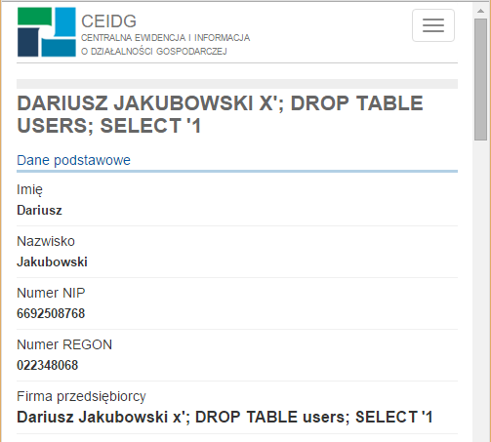
SQL Injection
Place SQL code in form controls ;)
Protect by:
Don’t concatenate parameters and form controls
Always validate user input. ALWAYS!
https://prod.ceidg.gov.pl/CEIDG/ceidg.public.ui/SearchDetails.aspx?Id=e82735cd-bc2b-4ac0-8bac-a1dc54d8c013

Slide 22

They see me rollin’
They patchin’

Slide 23
.NET is secured by default
By default .NET filters queries
Sometimes correct request is filtered out (e.g. html visual comment editor)
If you turn it off, sanitize user input – google 'Html Agility Pack'
Want more security? Require SSL
<system.web>
<httpRuntime requestValidationMode="2.0"/>
</system.web>
[RequireHttps]
public ActionResult Login()
{
return View();
}

Slide 24
Security
LAB 09 A LAB 09 B OPTIONAL
120 min

Slide 25
Module summary
Authentication vs Authorization
MVC security layers
Controlling access to resources
Designing secure applications
Microsoft ASP.NET Identity Framework
OAuth – integrating your application with Facebook

Slide 26
Questions?
Fragen
Spurningar
Vragen
Pytania
Otázky

Copyright © 2016 Adrian Ilewicz

